Slide 1

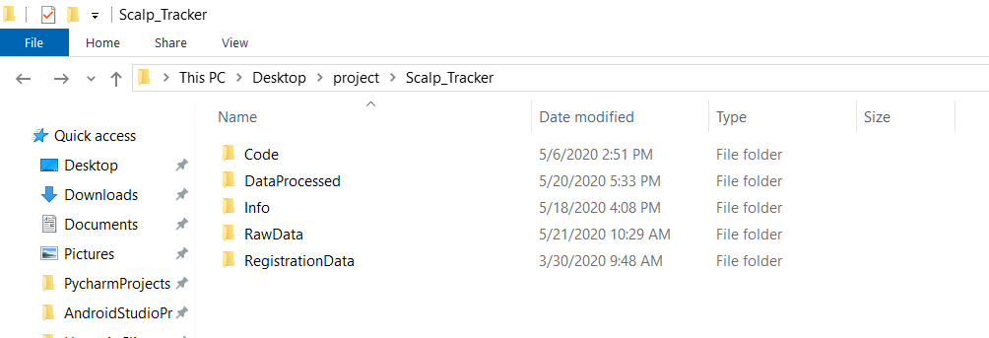
Data Export
Exporting the data from thread platform.
Saving that zip file in the Raw Data folder.
Generic structure for all the studies that are from Thread Platform.

Slide 2
Flow chart
Data Export
Data pipeline(Questions)
Data Pipeline(GpSkin)
Data pipeline(Analysis)
Data Insertion

Slide 3

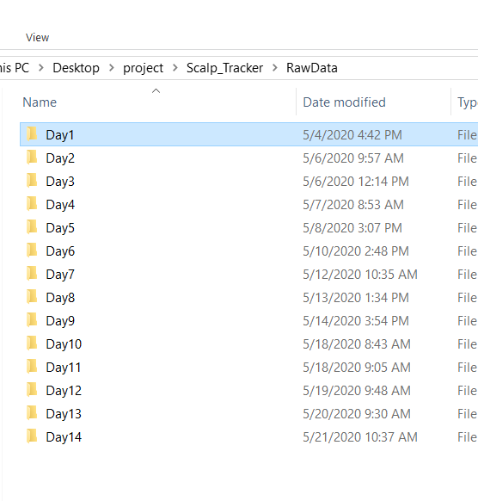
Tracking the Daily compliance reports from the study.

Slide 4
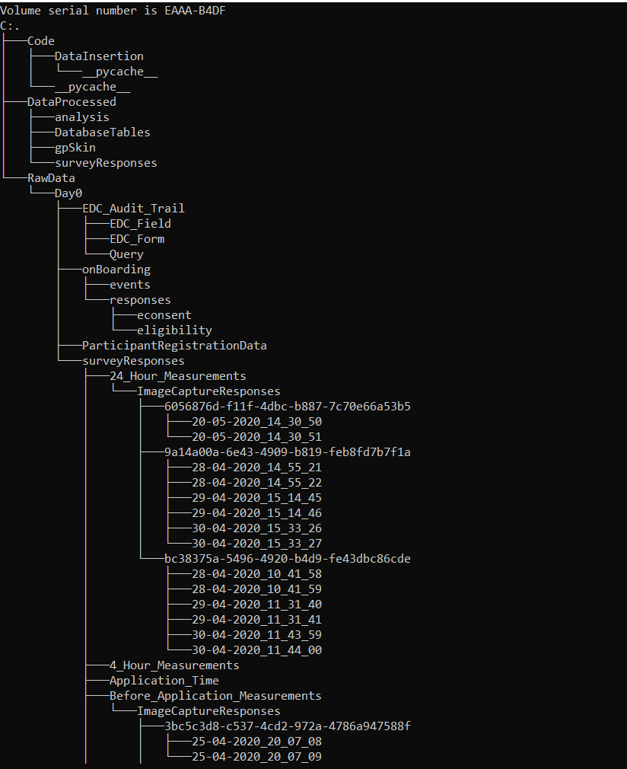
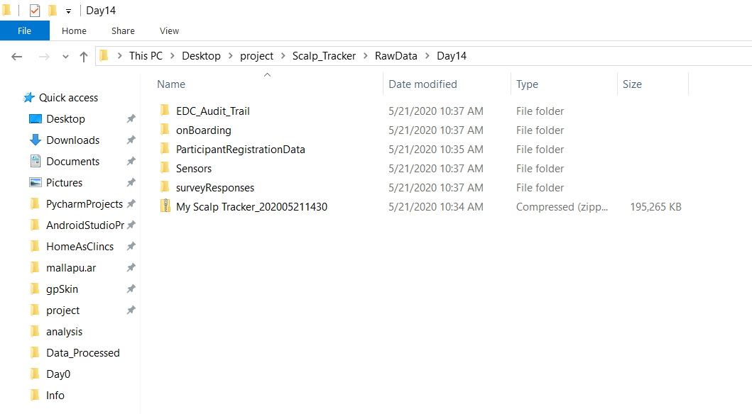
Saving the zip file in the corresponding day
Tree structure of a study

Slide 5
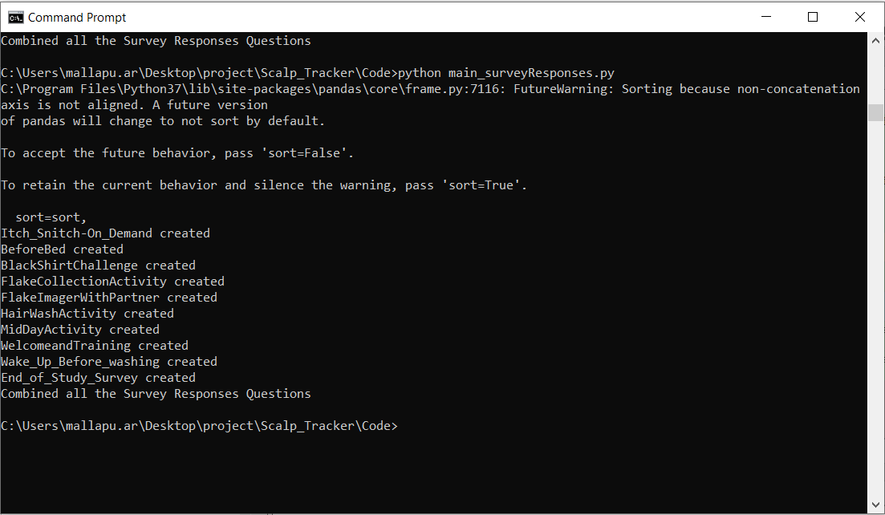
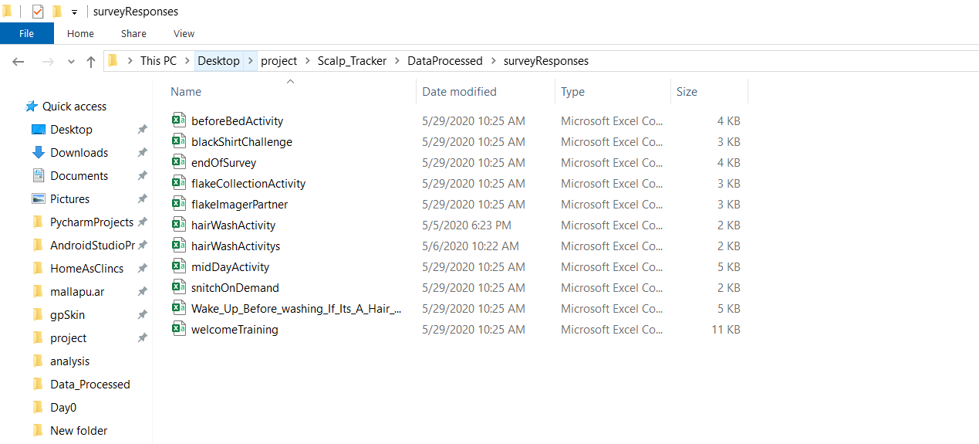
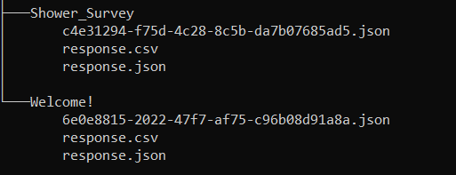
Data Pipeline (Questionnaire)
Extracting questions from survey responses
(Activities) Json files.

Slide 6
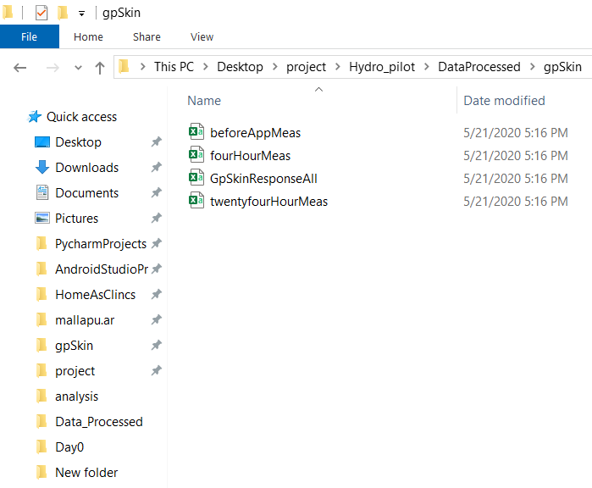
Pipeline (GpSkin)
Some of the studies will have gpSkin measurements.
python main_surveyResponses_gpskin.py --add "C:/Users/mallapu.ar/Desktop/project/Hydro_pilot/RawData/Day0“

Slide 7
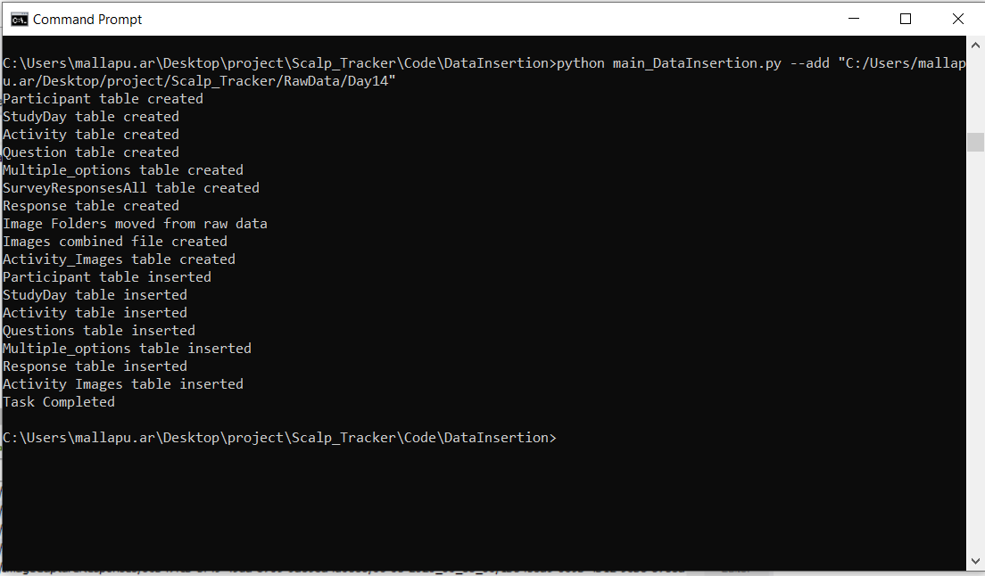
Inserting data into Database
Final step is to insert this data into the database.
python main_DataInsertion.py --add "C:/Users/mallapu.ar/Desktop/project/Scalp_Tracker/RawData/Day14"

Slide 8
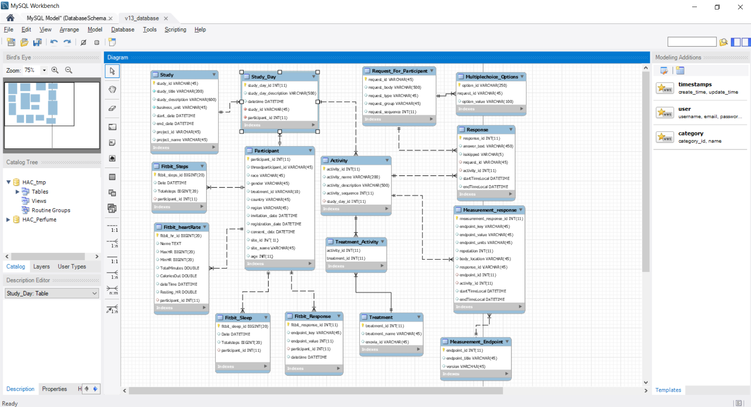
Database Schema

Slide 9
Scalp Tracker
This is a 2 week study and subjects have to complete activities at home. There are 40 subjects in the study. Start date is May 04th.
These daily activities will include answering short questions, taking images of your scalp using your phone, wearing a black shirt to see flakes on your shoulders, and performing a method where you comb flakes out of your scalp/hair onto a dark surface.
Scalp_Tracker App will also tell subjects when to wash your hair. Participants can use any shampoo they want, as long as it’s not a dandruff shampoo.

Slide 10
Scalp Tracker
Activities:
Welcome and Training
Black Shirt Challenge
Wake Up (Before Washing If It's A Hair Wash Day)
Flake Imager (With Partner) – (Img)
Flake Collection Activity – (Img)
Hair Wash Activity
Mid-Day Activity
Before Bed Activity
"Itch Snitch" - On Demand
End of Study Survey

Slide 11
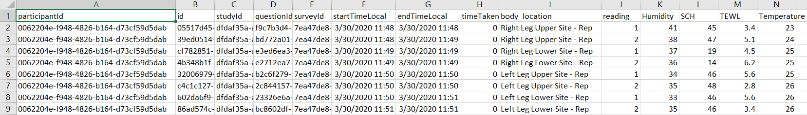
Leg Skin Barrier Study
ACTIVITIES:
Practice Skin Measurement
Wake Up Skin Measurement
Before Bed Skin Measurement
GpSkin Measurements are collected on Leg. There are two sites(Upper and Lower) on each Leg. In each site, subjects have to collect two gpSkin measures.
There are 30 active subjects in the study and the start date of this study is March 28th and end date is April 16th .

Slide 12
Hydro Pilot Team Test
This a 6 day study with 8 subjects in total. Start date of the study is 05/29.
Activities:
Welcome!
24 Hour Measurements (Img)
Shower Survey
Before Application Measurements (Img)
Product Application
Application Time
4 Hour Measurements

Slide 13
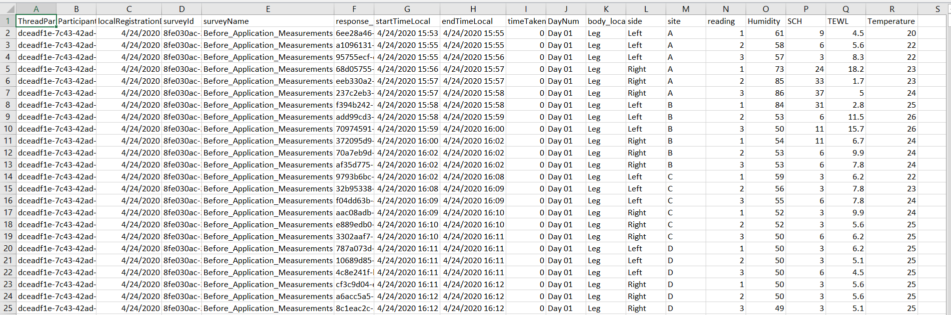
Hydro Pilot Team Test
GpSkin Measures are collected from three activities.(24 Hour Measurements, Before Application Measurements, 4 Hour Measurements).
The location is on Leg, Right and Left. Each Leg has 4 sites (A, B, C, D), In each site subjects has to take 3 measures.

Slide 14


